Slide 1
1090621期末複習

Slide 2

期末考
時間：109.06.24 (三) 15:30～17:20
要到學校考，地點：TR 309
範圍：ch11(除11.4, 11.5, 11.8) & ch12(全)
滿分140 !!!

Slide 3
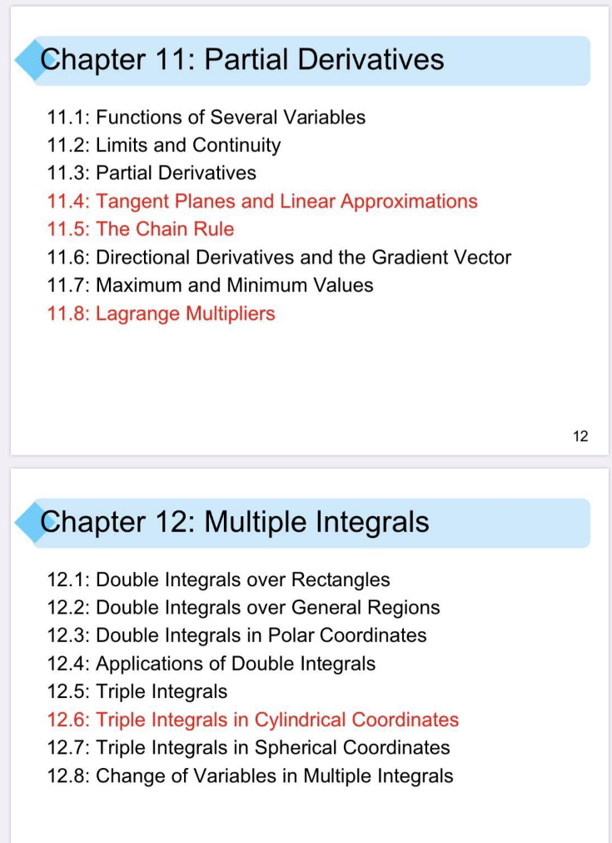
改成要考!!!

Slide 4
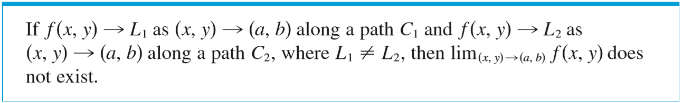
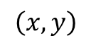
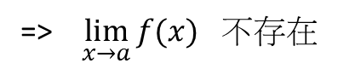

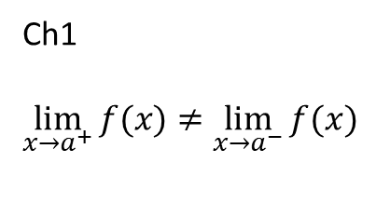

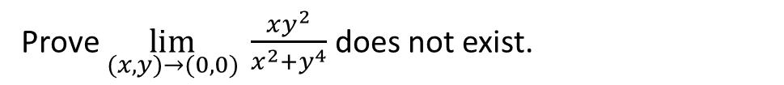

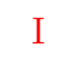
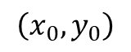
Prove $\lim_{(x,y)→(0,0)} \frac{xy^{2}}{x^{2}+y^{4}}$ does not exist.
$$Ⅱ$$
$$\left(x,y\right)$$
Ch1
$\lim_{x→a^{+}}{f(x)}≠$ $\lim_{x→a^{−}}{f(x)}$
$$Ⅳ$$
$$Ⅲ$$
$$Ⅰ$$
=> $\lim_{x→a}{f(x)}$ 不存在
$$\left(x_{0}, y_{0}\right)$$

Slide 5
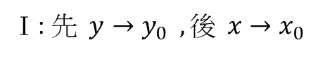

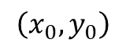

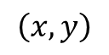


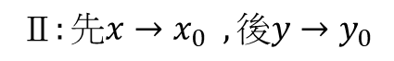
$$Ⅱ$$
$$\left(x,y\right)$$
$Ⅰ$: $先 y→y_{0} , 後 x→x_{0}$
$$Ⅳ$$
$$Ⅲ$$
$$Ⅰ$$
$$Ⅱ:先x→x_{0} , 後y→y_{0}$$
$$\left(x_{0}, y_{0}\right)$$
$Ⅲ$: 沿任意斜率m之直線$y−y_{0}=$m($x−$ $x_{0}$) 靠近($x−$ $x_{0}$)
$Ⅳ:$ 沿任意曲線$y−y_{0}={\text{(}x− x_{0}\text{)}}^{\text{m}}$ 靠近($x−$ $x_{0}$)

Slide 6
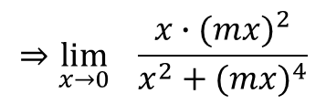
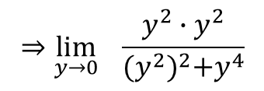
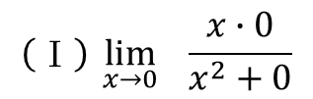
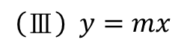
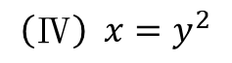
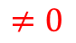
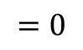
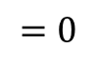
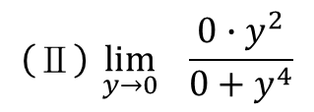
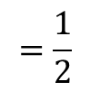
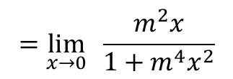
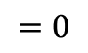
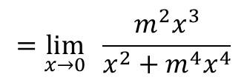
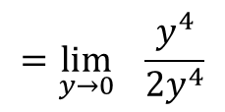
Prove $\lim_{(x,y)→(0,0)} \frac{xy^{2}}{x^{2}+y^{4}}$ does not exist.
$$\left(Ⅳ\right) x=y^{2}$$
$$\left(Ⅰ\right) \lim_{x→0}{ \frac{x∙0}{x^{2}+0}}$$
$$=0$$
$$⇒\lim_{y→0}{ \frac{y^{2}∙y^{2}}{{(y^{2})}^{2}+y^{4}}}$$
$$\left(Ⅱ\right) \lim_{y→0}{\frac{0∙y^{2}}{0+y^{4}}}$$
$$=0$$
$$=\lim_{y→0}{ \frac{y^{4}}{{2y}^{4}}}$$
$$\left(Ⅲ\right) y=mx$$
$$⇒\lim_{x→0}{ \frac{x∙{(mx)}^{2}}{x^{2}+{(mx)}^{4}}}$$
$$=\frac{1}{2}$$
$$≠0$$
$$=\lim_{x→0}{ \frac{m^{2}x^{3}}{x^{2}+{m^{4}x}^{4}}}$$
$$=\lim_{x→0}{ \frac{m^{2}x}{1+{m^{4}x}^{2}}}$$
$$=0$$
Ch11.1

Slide 7
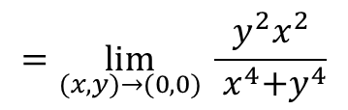
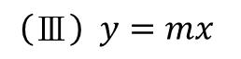
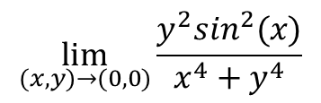
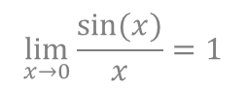
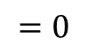
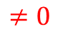
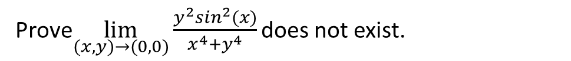
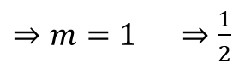
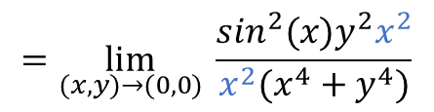
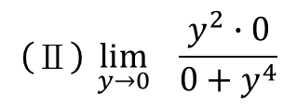
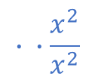
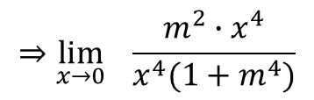
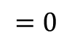
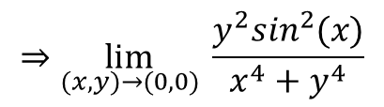
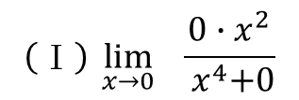
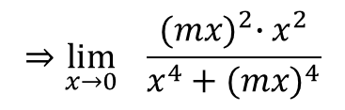
Prove$\lim_{(x,y)→(0,0)}\frac{y^{2}\sin^{2}(x)}{x^{4}+y^{4}}$ does not exist.
$$\left(Ⅰ\right) \lim_{x→0}{ \frac{0∙x^{2}}{{ x}^{4}+0}}$$
$$=0$$
$$\lim_{(x,y)→(0,0)}\frac{y^{2}\sin^{2}(x)}{x^{4}+y^{4}}$$
$$\left(Ⅱ\right) \lim_{y→0}{\frac{y^{2}∙0}{0+y^{4}}}$$
$$=0$$
$$⇒\lim_{(x,y)→(0,0)} \frac{y^{2}\sin^{2}(x)}{x^{4}+y^{4}}$$
$$∙ ∙\frac{x^{2}}{x^{2}}$$
$$\left(Ⅲ\right) y=mx$$
$$=\lim_{(x,y)→(0,0)} \frac{{\sin^{2}(x)y}^{2}x^{2}}{{x^{2}(x}^{4}+y^{4})}$$
$$\lim_{x→0}{\frac{sin⁡(x)}{x}=1}$$
$$⇒\lim_{x→0}{ \frac{{(mx)}^{2}∙x^{2}}{x^{4}+{(mx)}^{4}}}$$
$$=\lim_{(x,y)→(0,0)} \frac{y^{2}x^{2}}{{ x}^{4}+y^{4}}$$
$$⇒\lim_{x→0}{ \frac{m^{2}∙x^{4}}{x^{4}{(1+m}^{4})}}$$
$⇒m=1 ⇒$ $\frac{1}{2}$
$$≠0$$
Ch11.1

Slide 8

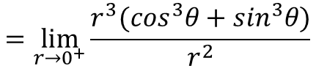
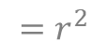
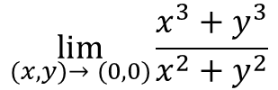
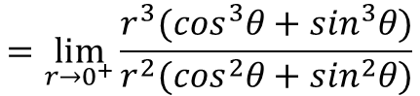
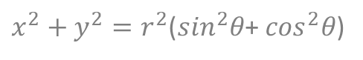
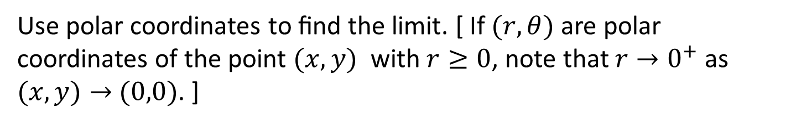
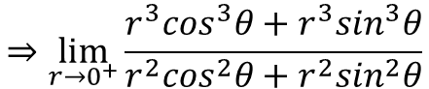
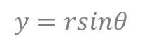



Use polar coordinates to ﬁnd the limit. [ If $(r,θ)$ are polar coordinates of the point $(x,y)$ with $r≥0$, note that $r→0^{+}$ as $(x,y)→$ $(0,0)$. ]
$$\lim_{(x,y)→ (0,0)}{\frac{x^{3}+y^{3}}{x^{2}+y^{2}}}$$
$$⇒\lim_{r→0^{+}}{\frac{r^{3}\cos^{3}θ+r^{3}\sin^{3}θ}{r^{2}\cos^{2}θ+r^{2}\sin^{2}θ}}$$
$$=\lim_{r→0^{+}}{\frac{r^{3}{(cos}^{3}θ+\sin^{3}θ)}{r^{2}(\cos^{2}θ+\sin^{2}θ)}}$$
$$let x=rcosθ$$
$$y=rsinθ$$
$$=\lim_{r→0^{+}}{\frac{r^{3}{(cos}^{3}θ+\sin^{3}θ)}{r^{2}}}$$
$x^{2}+y^{2}=r^{2}$($\sin^{2}θ$+ $\cos^{2}θ$)
$$=r^{2}$$
$$=\lim_{r→0^{+}}{r (\cos^{3}θ+\sin^{3}θ)}$$
$$=0$$
Ch11.2

Slide 9






$$f\left(x,y\right)=sin⁡(x^{3}+x^{2}y)$$
$$f_{x}\left(x,y\right)=?$$
$$f_{y}\left(x,y\right)=?$$
$f_{x}\left(x,y\right)=$ $\cos\left(x^{3}+x^{2}y\right)×(3x^{2}+2xy)$
$f_{y}\left(x,y\right)=$ $\cos\left(x^{3}+x^{2}y\right)×(0+x^{2})$
$=$ $x^{2}cos\left(x^{3}+x^{2}y\right)$
$$f_{yx}\left(x,y\right)=?$$
$$f_{yx}\left(x,y\right)=\left[2x∙cos\left(x^{3}+x^{2}y\right)\right]+{[−x}^{2}sin\left(x^{3}+x^{2}y\right)∙(3x^{2}+2xy)]$$
Ch11.3

Slide 10








$D_{\overset{→}{u}}f\left(3,−1,0\right)=?$ for $f\left(x,y,z\right)=4x−y^{2}e^{3xz}$
Direction of $\overset{→}{v}=\left\langle −1,4,2\right\rangle$
$D_{\overset{→}{u}}f\left(x,y,z\right)=$ $∇f\left(x,y,z\right)∙$ $\overset{→}{u}$
$$∇f\left(x,y,z\right)=\left\langle 4−y^{2}e^{3xz}∙3z, 0−2y^{2}e^{3xz}, 0−y^{2}e^{3xz}∙3z\right\rangle$$
$$=\left\langle 4−0, 0−2∙(−1)∙1, 0−{(−1)}^{2}∙1∙9\right\rangle$$
$$=\left\langle 4, 2, −9\right\rangle$$
$\overset{→}{u}=\frac{\overset{→}{v}}{|\overset{→}{v}|}$
$$\left|\overset{→}{v}\right|=\sqrt{{(−1)}^{2}+4^{2}+2^{2}}$$
$\overset{→}{u}=$ $\left\langle \frac{−1}{\sqrt{21}},\frac{4}{\sqrt{21}},\frac{2}{\sqrt{21}}\right\rangle$
$$=\sqrt{21}$$
Ch11.6

Slide 11




$D_{\overset{→}{u}}f\left(x,y,z\right)=$ $∇f\left(x,y,z\right)∙$ $\overset{→}{u}$
$=\left\langle 4, 2, −9\right\rangle$ $∙\left\langle \frac{−1}{\sqrt{21}},\frac{4}{\sqrt{21}},\frac{2}{\sqrt{21}}\right\rangle$
$$=\frac{−4+8−18}{\sqrt{21}}$$
$$=\frac{−14}{\sqrt{21}}$$
Ch11.6

Slide 12















$$\int_{0}^{1}{\int_{x}^{1}{\sin\left(y^{2}\right)dydx}}$$
$$y=x$$
$$y=1$$
$$\int{\sin\left(y^{2}\right)dy=???}$$
$$=\int{\int{\sin\left(y^{2}\right)dxdy}}$$
$$x=0$$
$$x=1$$
$$=\int_{0}^{1}{\int_{0}^{y}{\sin\left(y^{2}\right)dxdy}}$$
$$=\frac{1}{2}\int_{0}^{1}{\text{sin}\left({\text{y}}^{\text{2}}\right)2y \text{dy}}$$
$$=−\frac{1}{2}\text{cos}\left({\text{y}}^{\text{2}}\right)|_{0}^{1}$$
$$=\int_{0}^{1}{\text{sin}\left({\text{y}}^{\text{2}}\right)x|_{0}^{y} \text{dy}}$$
$$=\frac{1}{2}\int_{0}^{1}{\text{sin}\left({\text{y}}^{\text{2}}\right)\text{d}{\text{y}}^{\text{2}}}$$
$$=\frac{1}{2}\left(1−cos⁡(1)\right)$$
$$=\int_{0}^{1}{\text{sin}\left({\text{y}}^{\text{2}}\right)y \text{dy}}$$
$$=−\frac{1}{2}\text{cos}\left({\text{y}}^{\text{2}}\right)|_{0}^{1}$$

Slide 13
各位期末考加油!

